Slide 1


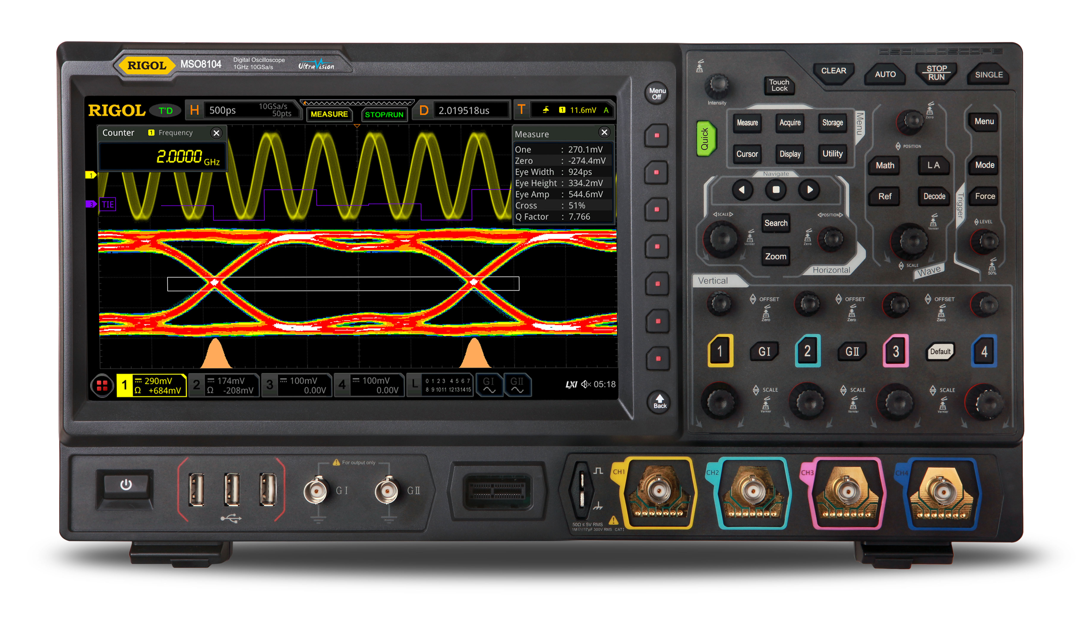
DBSP: Incremental Computation on Streams and Its Applications to Databases
Mihai Budiu – .
September 19, 2024
UT Austin

Slide 2
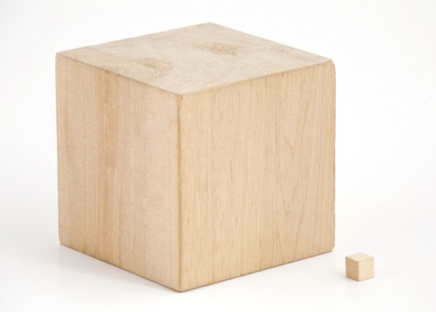
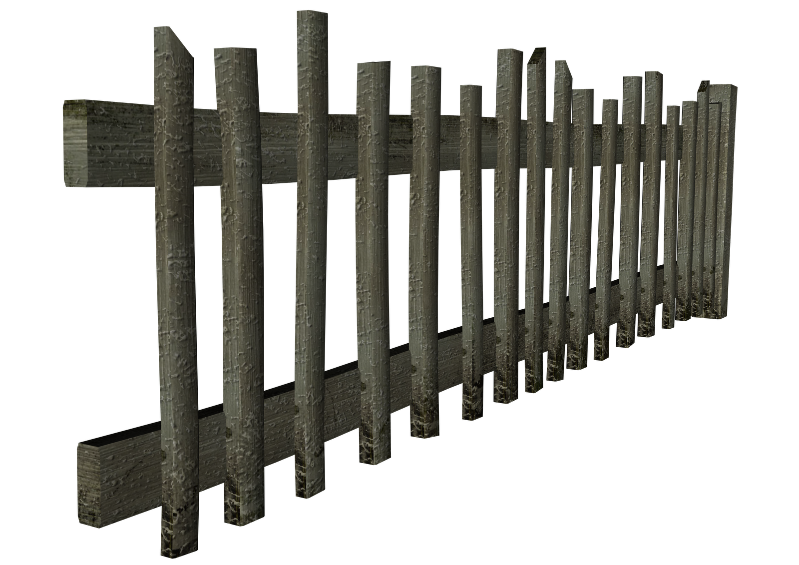
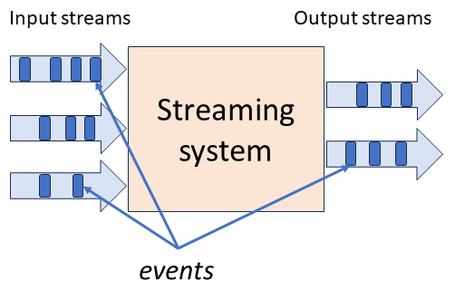
stream
DB
IVM
IVM
Database

Slide 3


Resources
Best paper award
DBSP: Automatic Incremental View Maintenance for Rich Query Languages Mihai Budiu, Tej Chajed, Frank McSherry, Leonid Ryzhyk, Val Tannen
DBSP: Incremental Computation on Streams and Its Applications to Databases
github.com/feldera/feldera
ACM SIGMOD 2024 Research
Highlights
Award

Slide 4



Setup: A database and a query
$$Q$$

Slide 5

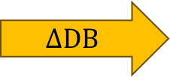

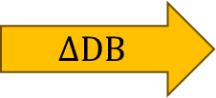



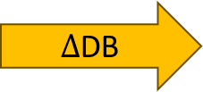

Periodic query evaluation
CREATE VIEW V AS SELECT … FROM …
V
V
V
V
V
$$Q$$
$$Q$$
$$Q$$
$$Q$$
$$Q$$
$Δ$DB
$$ΔDB$$
$$ΔDB$$
$$ΔDB$$
$$ΔDB$$
~100 rows
~1B rows
Time
transactions

Slide 6

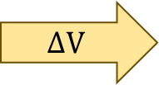


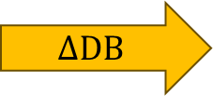


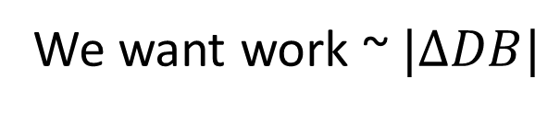



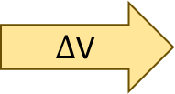
Incremental View Maintenance
We want work ~$|ΔDB|$
V
V
V
V
V
$$ΔV$$
$$ΔV$$
$$ΔV$$
$$ΔV$$
$Δ$V
$$Q$$
$$Q^{Δ}$$
$$Q^{Δ}$$
$$Q^{Δ}$$
$$Q^{Δ}$$
$$Q^{Δ}$$
$$ΔDB$$
$$ΔDB$$
$$ΔDB$$
$$ΔDB$$
$$ΔDB$$
Time

Slide 7

Outline
Incremental View Maintenance
Stream computations
Databases as streaming systems
Incremental computation on streams
SQL in DBSP
Implementation

Slide 8
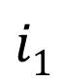

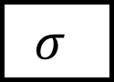
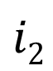
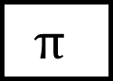

Dataflow graphs (query plans)
Boxes = computations
Arrows = values
$$Q$$
$$i1$$
$$σ$$
$$⋈$$
o
$$i2$$
$$π$$

Slide 9

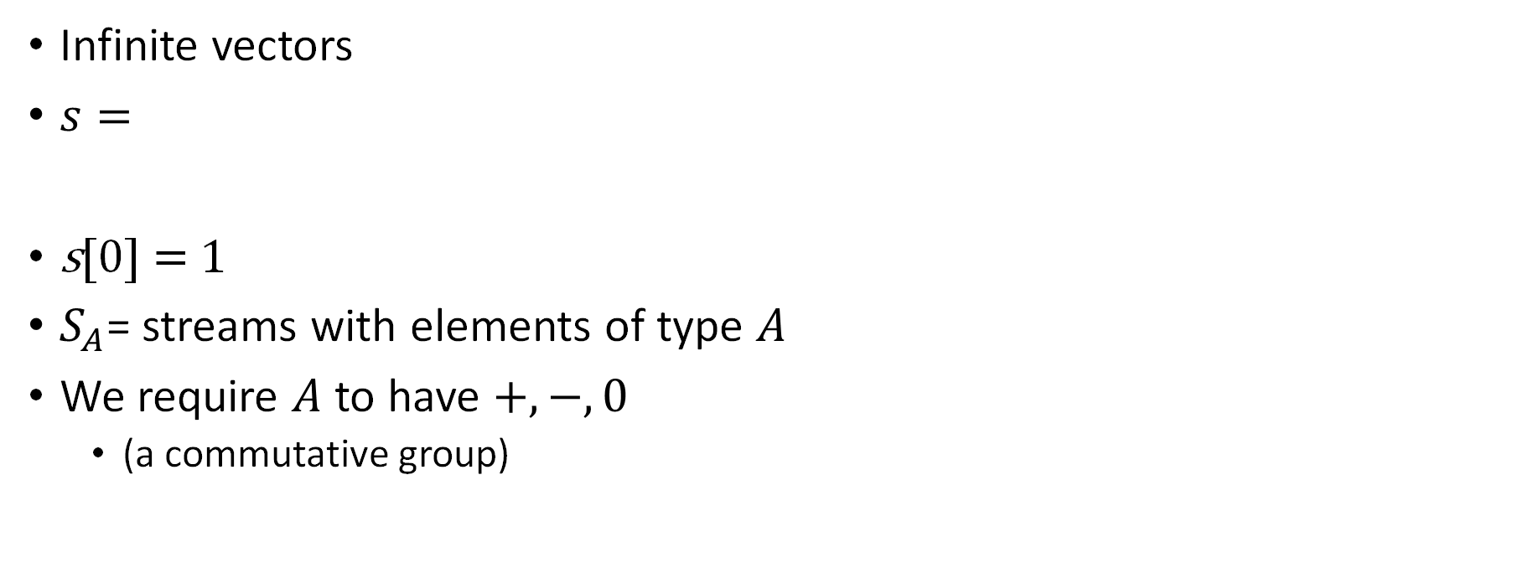
Streams
Infinite vectors
$s=$
s[0] = 1
$S_{A}$= streams with elements of type $A$
We require $A$ to have $+, −, 0$
(a commutative group)
…
-1
-2
-1
0
1
2
1
time

Slide 10
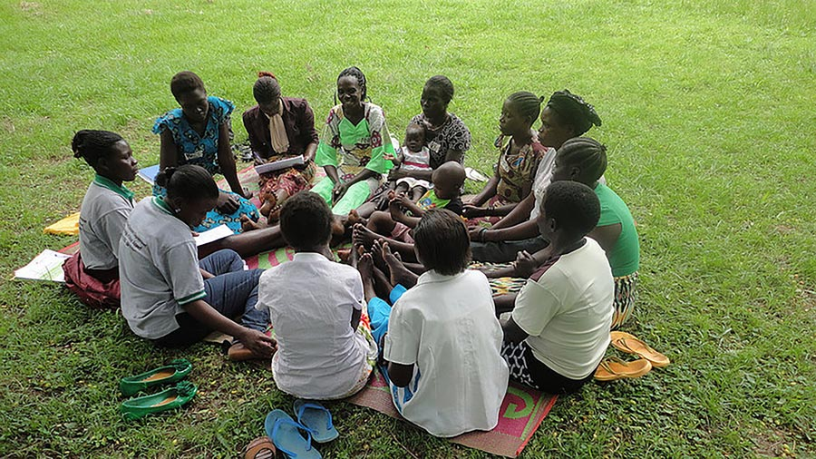
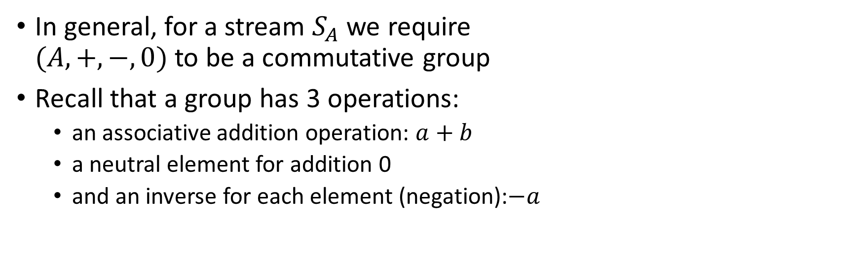
Groups
In general, for a stream $S_{A}$ we require $(A, +, −, 0)$ to be a commutative group
Recall that a group has 3 operations:
an associative addition operation: $a+b$
a neutral element for addition 0
and an inverse for each element (negation):$−a$

Slide 11
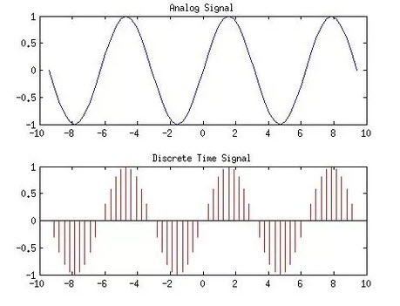
Analog and digital signals
Analog to digital conversion
Digital to analog conversion

Slide 12
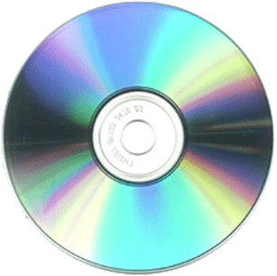
Nyquist–Shannon sampling theorem
If a signal contains no frequencies higher than B hertz, it is completely determined by giving its values at a series of points spaced 1/(2B) seconds apart.
Our ears cannot hear more than 20khz
CDs sampling rate is 44.1khz
Analog signal
Analog circuit
Analog signal
A/D
D/A
Digital signal
Program
Digital signal

Slide 13
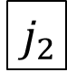
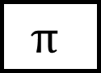
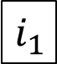
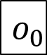

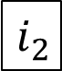
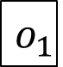
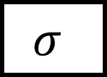
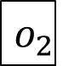
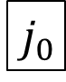
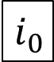
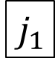
Stream computations
Inputs and outputs are streams
double arrows
…
$$i_{2}$$
$$i_{1}$$
$$i_{0}$$
$$σ$$
$$⋈$$
…
$$o_{2}$$
$$o_{1}$$
$$o_{0}$$
…
$$j_{2}$$
$$j_{1}$$
$$j_{0}$$
$$π$$

Slide 14
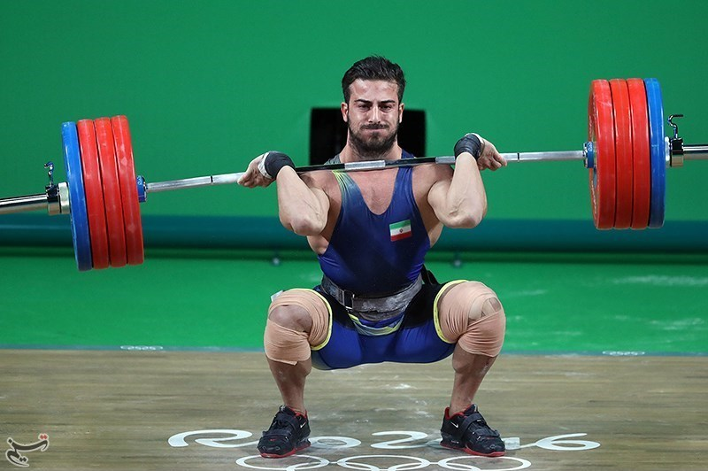
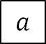
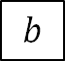
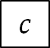
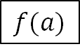
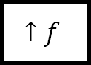
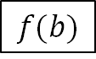
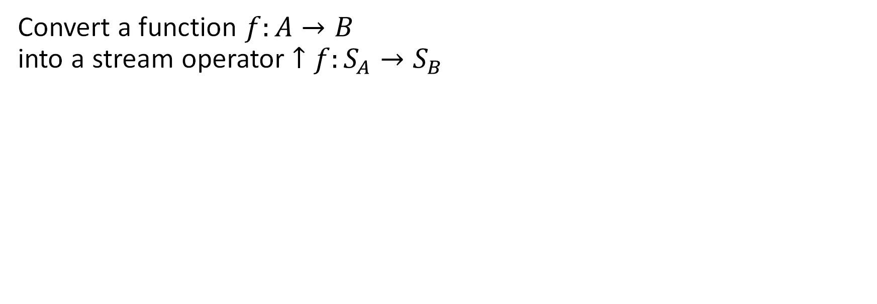
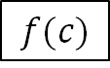
Lifting
Convert a function $f:A→B$ into a stream operator $↑f:S_{A}→S_{B}$
…
$$c$$
$$b$$
$$a$$
$$↑f$$
…
$$f(c)$$
$$f(b)$$
$$f(a)$$

Slide 15

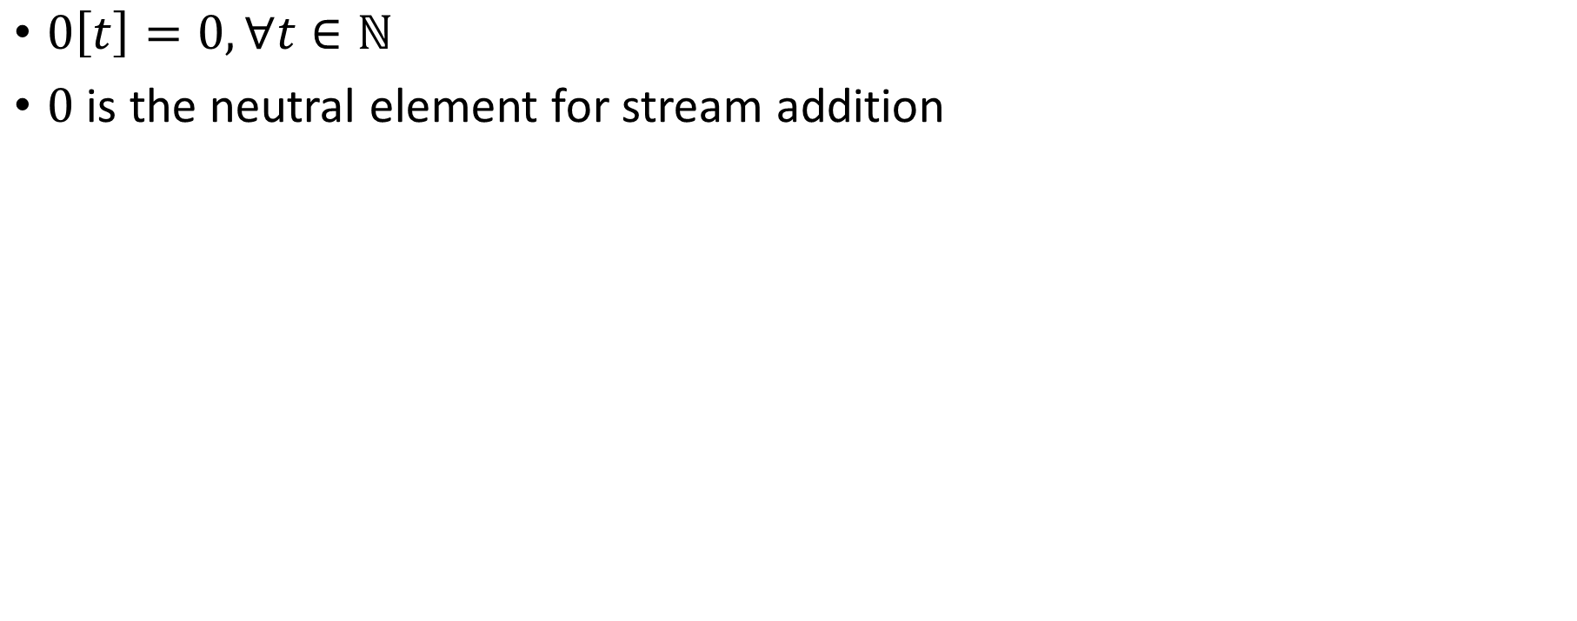
Silence
$0\left[t\right]=0, ∀t∈ℕ$
$0$ is the neutral element for stream addition

Slide 16
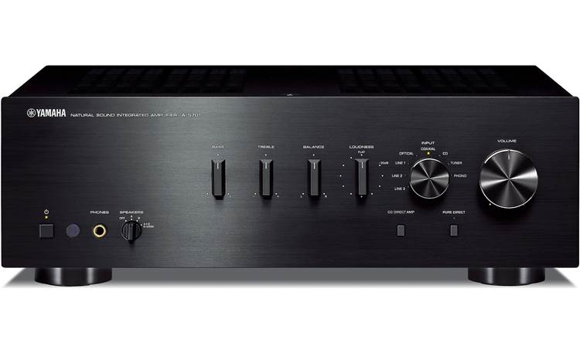
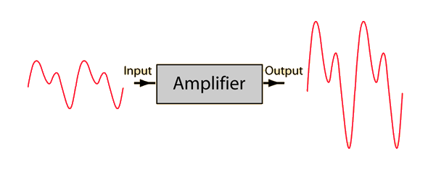
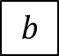
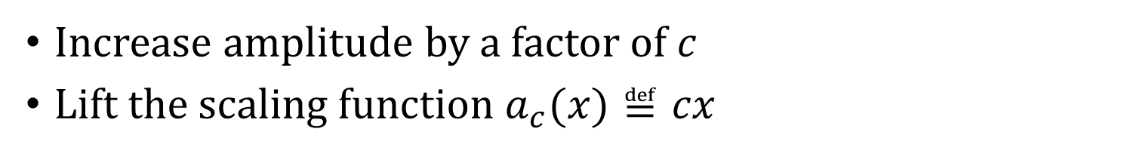
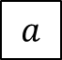
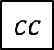
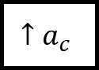
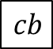
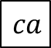

Amplification
Increase amplitude by a factor of $c$
Lift the scaling function $a_{c}(x)≝cx$
$$a$$
$$b$$
$$c$$
…
$$↑a_{c}$$
$$ca$$
$$cb$$
$$cc$$
…

Slide 17









Negation
Lifted unary minus
$−:S_{ℝ}→S_{ℝ}$
$\left(− s\right)\left[t\right]=−(s\left[t\right])$
$$a$$
$$b$$
$$c$$
…
$$−$$
$$−a$$
$$−b$$
$$−c$$
…

Slide 18


Delay ($z^{−1}$ )
Output is input stream delayed by one step
First value is 0
Stores internal state (the only operator with state)

Slide 19

Noise cancellation
Predict future values (easy for periodic signals)
Generate a negated stream
Add it to original stream
i
+
o
-

Slide 20









Computing changes (deltas) Differentiation
$$o\left[t\right]=s\left[t\right]–s\left[t−1\right]$$
$$D$$
$$o$$
o is the stream of changes of s
…
$$2$$
$$3$$
$$2$$
1
$$D$$
…
$$−1$$
$$1$$
$$1$$
1
stream of deltas

Slide 21









Integration
$$I$$
$o[0] =s[0]$
$o[t] =s[t] + o[t−1]$
$o\left[t\right]=s\left[0\right]+s\left[1\right]+ …+s[t]$
$$s$$
$$o$$
If s is a stream of changes…
… then o is the original stream
…
$$−1$$
$$1$$
$$1$$
1
$$I$$
…
$$2$$
$$3$$
$$2$$
1
stream of deltas

Slide 22

$D$ and $I$ “cancel out”

Slide 23





DB+= $Δ$
$$Δ[2]$$
$$Δ[1]$$
$$Δ[0]$$
Stream of experiences

Slide 24
Outline
Incremental View Maintenance
Stream computations
Databases as streaming systems
Incremental computation on streams
SQL in DBSP
Implementation

Slide 25










All databases are streaming databases!
Consider a database $DB$, a set of tables
A committed transaction is a change to $DB$
The set of linearized transactions define $T,$ a stream of changes to $DB$
$T[k]$is the $k$-th transaction
$DB$ is a stream of database snapshots
$DB[k]$ is the contents of the database after $k$ transactions have been committed
$DB[k] = I(T)[k$]
A database (stream) is the integral of a transaction stream
…
$$T_{3}$$
$$T_{2}$$
$$T_{1}$$
$$T_{0}$$
$$I$$
…
$${DB}_{3}$$
$${DB}_{2}$$
$${DB}_{1}$$
$${DB}_{0}$$

Slide 26














Views are lifted queries
Let $Q$ be a query defining a view $V$
$V[k]=Q\left(DB[k]\right)$
$V$ is a stream of view snapshots:
$$V= ↑Q(DB)$$
$$↑Q$$
$$…$$
$$V_{3}$$
$$V_{2}$$
$$V_{1}$$
$$V_{0}$$
Versions of $V$
Versions of $DB$
$$…$$
$${DB}_{3}$$
$${DB}_{2}$$
$${DB}_{1}$$
$${DB}_{0}$$

Slide 27








Some interesting streams
Stream of database
snapshots
DB[0]
DB[1]
DB[2]
DB[3]
$$ΔDB[0]$$
$$ΔDB[1]$$
$$ΔDB[2]$$
$$ΔDB[3]$$
… transactions
V[0]
V[1]
V[2]
V[3]
… view
snapshots
$ΔV$[0]
$ΔV$[1]
$$ΔV[2]$$
$$ΔV[3]$$
… view
changes

Slide 28
Outline
Incremental View Maintenance
Stream computations
Databases as streaming systems
Incremental (DB) computations
SQL in DBSP
Implementation

Slide 29



Views are lifted queries
$$Q$$
$$Q$$
V
V
V
V
$$↑Q$$

Slide 30

















Incremental view maintenance of view $V$
$${(↑Q)}^{Δ}$$
$$…$$
$$T_{2}$$
$$T_{1}$$
$$T_{0}$$
$$I$$
$$↑Q$$
D
$$…$$
$$ΔV_{2}$$
$$ΔV_{1}$$
$$ΔV_{0}$$
Changes to $DB$
Changes to $V$
$$…$$
$$V_{2}$$
$$V_{1}$$
$$V_{0}$$
Versions of $V$
Versions of $DB$
$$…$$
$${DB}_{2}$$
$${DB}_{1}$$
$${DB}_{0}$$

Slide 31











Incremental view maintenance
This is our definition of IVM
This definition is much better:
It is compositional
Inputs and outputs are both deltas
This works, but is inefficient
$${(↑Q)}^{Δ}$$
$$…$$
$$T_{2}$$
$$T_{1}$$
$$T_{0}$$
$$I$$
$$↑Q$$
D
$$…$$
$$ΔV_{2}$$
$$ΔV_{1}$$
$$ΔV_{0}$$
Changes to $DB$
Changes to $V$
…
$$V_{2}$$
$$V_{1}$$
$$V_{0}$$
Versions of $V$
$$…$$
$${DB}_{2}$$
$${DB}_{1}$$
$${DB}_{0}$$
Versions of $DB$

Slide 32










Incremental queries are streaming systems
$${Δi}_{0}$$
$${Δi}_{1}$$
$${Δi}_{2}$$
$${Δi}_{3}$$
…
$$Q^{Δ}$$
$$Δo_{0}$$
$$Δo_{1}$$
$$Δo_{2}$$
$$Δo_{3}$$
…
state
$Q^{Δ}$ is a streaming system:
it runs forever
it maintains internal state (even if $Q$ is stateless)
the state is stored in the delay operators (inside $I$ and $D$)

Slide 33







Linear operators
$Q$ is linear if $Q(a+b) = Q(a) + Q(b)$
If $Q$ is linear: $Q=Q^{Δ}$
Most relational queries use linear operators!
$${(↑Q)}^{Δ}$$
$$…$$
$$T_{2}$$
$$T_{1}$$
$$T_{0}$$
$$I$$
$$↑Q$$
D
$$…$$
$$ΔV_{2}$$
$$ΔV_{1}$$
$$ΔV_{0}$$

Slide 34


The chain rule
$$(Q_{2}{∘Q_{1})}^{Δ}=Q_{2}^{Δ}∘Q_{1}^{Δ}$$
Proof by pictures:

Slide 35


Bilinear operators
(Lifted) join, intersection, Cartesian product
$Δ\left(A×B\right)=\left(A×ΔB\right)+\left(ΔA×B\right)+\left(ΔA×ΔB\right)$

Slide 36
Outline
Incremental View Maintenance
Stream computations
Databases as streaming systems
Incremental computation on streams
SQL in DBSP
Implementation

Slide 37


Hold on! This is not well-defined!
The definitions of $I$, $D$ require streams over a commutative group
However, tables (sets, multisets) are not groups
E.g., there is no table negation

Slide 38

$ℤ$-sets
Each row has an integer weight
The weight can be positive, zero, or negative
Name | Age | Weight
Mike | 10 | 1
John | 12 | 3
Amy | 8 | -1
Chris | 10 | 2
tuples

Slide 39



$ℤ$-sets are magic!
Can represent both tables and changes to tables
Positive weights = elements added
Negative weights = elements removed
Generalize sets and multisets
Classic DB table = $ℤ$-set where all weights are 1
Form a commutative group (because $ℤ$ is a group)

Slide 40



Relational algebra in $ℤ$-sets
Recursively defined on query structure
Many operations require a $distinct$
(But some can be removed)
The other operations are all linear or bilinear
Can also model
Group-by
Unnest
Aggregation
Recursion

Slide 41


Algorithm for incremental view maintenance
Translate recursively a DB query into a circuit $Q$ on $ℤ$-sets
Lift circuit to compute on streams: $↑Q$
Build incremental version of lifted circuit:
Optimize $Q^{Δ}$ using chain rule:
$$(Q{∘R)}^{Δ}=Q^{Δ}∘R^{Δ}$$
This algorithm is deterministic. There are no heuristics.

Slide 42

Example: (1) create circuit
CREATE VIEW V AS SELECT DISTINCT a.x, b.y FROM ( SELECT t1.x , t1.id FROM t1 WHERE t1.a > 2 ) a JOIN ( SELECT t2.id , t2.y FROM t2 WHERE t2.s > 5 ) b ON a.id = b.id
Inputs and outputs are collections, not streams

Slide 43

Remove distinct calls
⬄

Slide 44


(2) Lift and (3) Incrementalize
(2)
Inputs and outputs are streams
(3)
Incrementalize:
Inputs and outputs are streams of changes

Slide 45



(4) optimize
Chain rule
Linearity
Expand join and distinct

Slide 46

No compromises!
Any SQL queries
Any number of queries, including recursive queries
Any mix of data sources
tables and “streams,” any number of them
Any data changes to the tables and streams, inputs and outputs
insertions, deletions, updates
Incrementally evaluated (work proportional to the size of the changes)
Incremental view maintenance
Exact SQL semantics
Fully deterministic execution, transactional semantics, “strong consistency”
Simple data representation and algorithms
Uniform data and change representation and computation
Computations on unbounded streams
using finite memory

Slide 47


The main tricks
Streams of snapshots
IVM: from changes to changes
$ℤ$-sets: model negative & positive changes

Slide 48
Outline
Incremental View Maintenance
Stream computations
Databases as streaming systems
Incremental computation on streams
SQL in DBSP
Implementation

Slide 49

Formal verification
Theory was verified using the Lean theorem prover
https://github.com/tchajed/database-stream-processing-theory
First formally-specified and formally-verified theory of incremental view maintenance
We know exactly what we need to build

Slide 50

DBSP Library
https://crates.io/crates/dbsp
MIT license
Rust framework to describe DBSP circuits
Support for relational algebra, nested relations, aggregates, etc.
Basic incremental and non-incremental operators (~70)
Multi-core execution

Slide 51
Interacting with the outside world
SQL program
Java
schema
SQL compiler
Rust
data
Z-sets
Z-sets
data
Data
source
DBSP
query engine
Data
sink
transport
decode
encode
transport
input
adapter
output
adapter
state

Slide 52
SQL compiler
SQL program
Calcite parser
Calcite planner
Calcite IR
DBSP IR
SQL compiler
user-
defined functions
SQL
runtime
library
DBSP optimizer
Rust codegen
Rust code
Rust compiler
exe
DBSP
library
I/O
Adapters
library

Slide 53



Feldera cloud service
data
data
data
pipeline
data
execution service
data
pipeline
data
data
data
pipeline
data
pipeline
SQL compiler
Rust compiler
compiler server
persistent
state DB
metrics service
storage service
pipeline manager
http
external
authentication
service

Slide 54




try.feldera.com
github.com/feldera/feldera
www.feldera.com/community

Slide 55
Extra slides

Slide 56

Why hasn’t anyone done this yet?
Today’s DBs cannot handle negative changes
Existing IVM algorithms have many restrictions

Slide 57

Normalized throughput compared to Flink on Nexmark benchmark

Slide 58

$ℤ$-set addition
Name | Weight
Mike | 1
John | 3
Amy | -1
Chris | 2
Name | Weight
Mike | -1
Dan | 1
Chris | 1
Name | Weight
Dan | 1
John | 3
Amy | -1
Chris | 3
+
=

Slide 59


Incremental operators
$(Q_{2}{∘Q_{1})}^{Δ}=Q_{2}^{Δ}∘Q_{1}^{Δ}$
If we know $Q^{Δ}$ for all primitive operations… …then we can incrementalize any query
For all standard primitive DB operations we know efficient incremental versions

Slide 60
A linear query
CREATE VIEW V AS SELECT * FROM T WHERE Age >= 10
“Shardable” queries
You don’t need to know what’s in T to compute the changes to V

Slide 61
DBSP Library
https://crates.io/crates/dbsp
MIT license
Rust framework to describe DBSP circuits
Support for relational algebra, nested relations, aggregates, etc.
Basic incremental and non-incremental operators (~70)
Multi-core execution
Currently in-memory

Slide 62
SQL to DBSP compiler
https://github.com/feldera/feldera/tree/main/sql-to-dbsp-compiler
MIT license
Generates Rust/native code programs using DBSP as a runtime
Based on Apache Calcite
Passes all 5+ million Sql Logic Test tests

Slide 63
Summary
Streaming systems run forever
A table is the integral of a stream
A transaction is the delta of a database
The right definition of IVM: computing changes to views given changes to tables
IVM systems are streaming systems
Almost any query has an efficient incremental implementation
The algorithm to incrementalize a given query is plan trivial:
Just incrementalize each primitive operator in the query
We built all this stuff as O/S
If you have a streaming or IVM problem, consider trying DBSP/Feldera

Slide 64







How to compute on changes?
CREATE VIEW V AS SELECT * FROM T WHERE Age >= 10
V
V
$$Q$$
$$Δ$$
$$Q$$
$$Q^{Δ}$$
$$ΔV=$$
SELECT * FROM $Δ$T WHERE Age >= 10
?
$$Q^{Δ}$$
$$Δ$$

Slide 65



This is what this work is about
$$Q$$
algorithm
$$Q^{Δ}$$
Work($Q^{Δ}$)/Work($Q$) = $O(|ΔT|/|T|)$
For essentially any query $Q$ you can write in any of the mainstream languages

Slide 66

It’s not always obvious
CREATE VIEW V AS SELECT DISTINCT * FROM T WHERE Age >= 10
$$Q$$
?
$$Q^{Δ}$$

Slide 67


Trade-offs
In general $Q^{Δ}$ can be much faster
But it may maintain a lot of internal state (indexes)
Time-space trade-off
$ΔV$ can be itself large
There is no easy way to change $Q$ itself
You can always use brute-force:
Feed the entire database as a big change

Slide 68


The distinct operator
“Converts” a $ℤ$-set into a set
Name | Weight
Dan | 1
John | 3
Amy | -1
Chris | 3
Name | Weight
Dan | 1
John | 1
Chris | 1
$$distinct\left( \right)=$$

Slide 69



The cycle rule
$$⇔$$
Allows us to recursively incrementalize circuits with feedback
All our circuits are built from:
Sequential composition
Feedback loops
We get a structural recursion scheme for incrementalizing any circuit

Slide 70
Multiset union (can have duplicates)
SELECT * FROM T1 UNION ALL SELECT * FROM T2
T1
+
V
T2

Slide 71

Set union (no duplicates)
SELECT * FROM T1 UNION SELECT * FROM T2
T1
+
$$distinct$$
V
T2

Slide 72

Set difference
SELECT * FROM T1 EXCEPT SELECT * FROM T2
T1
+
$$distinct$$
V
T2
-
Recall: distinct removes elements with negative weights

Slide 73


Query composition
SELECT … FROM (SELECT … FROM T)
T
$$Q_{1}$$
$$Q_{2}$$
V
Query composition is circuit chaining (function composition).

Slide 74
Set intersection
SELECT * FROM T1 INTERSECT SELECT * FROM T2
O(x) :- T1(x), T2(x).
This is a disguised JOIN. We will see it soon.

Slide 75






Projection
SELECT Age FROM T
In DDlog:
O(age) :- T(_, age).
The weight of $t$ = sum of weights of all tuples that project to $t$
$$π_{C}\left(m\right)\left[t\right]=\sum_{\begin{aligned}x∈m \\ π_{C\left(x\right)}=t\end{aligned}}{m[x]}$$
$$T$$
$${↑π}_{C}$$
$$distinct$$
$$V$$
Name | Age | Weight
Mike | 10 | 1
John | 12 | 3
Amy | 8 | -1
Chris | 10 | 2
Age | Weight
10 | 1+2
12 | 3
8 | -1
SELECT Age

Slide 76
Selection (filtering)
SELECT * FROM T WHERE predicate
O(t) :- T(t), predicate(t).
Name | Age | Weight
Mike | 10 | 1
John | 12 | 3
Amy | 8 | -1
Chris | 10 | -2
Name | Age | Weight
Mike | 10 | 1
John | 12 | 3
Chris | 10 | -2
WHERE Age >= 10

Slide 77
Cartesian products
V(t1, t2) :- T1(t1), T2(t2).
SELECT T1.*, T2.* FROM T1, T2
Name | Age | Weight
Mike | 10 | 1
John | 10 | 3
Amy | 10 | -1
Chris | 10 | 2
Mike | 12 | 3
John | 12 | 9
Amy | 12 | -3
Chris | 12 | 6
Name | Weight
Mike | 1
John | 3
Amy | -1
Chris | 2
Age | Weight
10 | 1
12 | 3
x
=
Multiply weights.

Slide 78




Optimizing distinct
Distinct is idempotent: $distinct∘distinct=distinct$
For many relational queries $Q$ the following holds ($Q$ one of select, project, join, map, flatmap, union, intersection)
For Q in join, product, filter, select we have
$$⇔$$
$$⇔$$

Slide 79



Incremental distinct
$$⇔$$
Work proportional to $|d|!$

Slide 80

Related work
Incremental View Maintenance
Streaming Databases
Streaming languages
Functional Languages
Category theory
Dataflow machines
Synchronous circuits

Slide 81


Materialized View Update Problem
We essentially cover this whole space
IEEE Data Engineering Bulletin, 1995

Slide 82



The ring of weights ($ℤ)$
The multiplication of $ℤ$ shows up in the join implementation …
… where weights of matching keys are multiplied
That’s why joins are bilinear (because $×$ distributes over $+$)

Slide 83

Additional SQL operations
Map (select)
Group-by (nested relations)
Flatmap
Aggregation
Order-by: not a particularly efficient model in DBSP

Slide 84


map_keys(f)
Generalization of SQL SELECT
Given $f:A→B$ the operator map_keys$\left(f\right):ℤ\left[A\right]→ ℤ[B]$ is: map_keys$\left(f\right)\left(i\right)=\sum_{x∈i}{i\left[x\right]⋅f(x)}$
Apply $f$ to each key and “weigh” the result
map_keys$(f)$is linear for any function $f$
Weight of $x$

Slide 85

Groupings
A grouping maps a key to a $ℤ$-set: $K→ℤ\left[A\right]$
Given a key, return a $ℤ$-set
This structure is $ℤ\left[A\right]\left[K\right]$
This is a mathematical group!
Weight
Key | Z-set
K1
K2
K3

Slide 86

Group-by
Given a type of keys $K$ and a function $k: A→K$, groupby$\left(k\right): ℤ\left[A\right]→ℤ\left[A\right]\left[K\right]$ builds a grouping from a $ℤ$-set
groupby is a linear function!
Each tuple in the input delta will affect only one grouping
So ($↑$groupby)$Δ =$ ($↑$groupby)

Slide 87

Aggregation
Aggregation functions such as weighted SUM and COUNT are linear functions $ℤ\left[ℝ\right]→ℝ$!
$a_{SUM}(s)=\sum_{x∈s}{x×s\left[x\right]}$
(But not linear as functions $ℤ\left[ℝ\right]→ℤ[ℝ]$!)
SELECT SUM(c) FROM I
makeset converts a $ℝ$scalar into a singleton $ℤ$-set
makeset(5) = $\{ 5↦1 \}$
makeset is not linear, but it is not expensive to incrementalize

Slide 88

Non-linear aggregations
E.g., min, max
… or their generalization, top-K
These are not linear on a group structure (they are linear on a monoid… but can’t handle negation)
Implemented using the “brute force” formula:
$${(↑Q)}^{Δ}= D∘(↑Q)∘I$$
The integral is there to “remember” the full set
Can be built efficiently (log work in $|I|$) using a priority queue

Slide 89
Group-By + Aggregate
The composition of
Group-by
map_weights(aggregate)
map_weights applies a function to each grouping
Not to be confused with map_keys from before
Linear if the aggregate function is linear

Slide 90


Parallelization
Join on two threads
Volcano “exchange” operator (from 2 threads to 3 threads)

Slide 91

Convolutions
Window-based computation
Window is defined by the input transactions (not by the contents of the data stream)

Slide 92


Streaming joins
$t$ are changes to a table
$s$ is a stream
Table $I(t)$ is joined with every stream value in $s$
$o$ is also a stream

Slide 93


Streaming window queries
$θ$ is a stream of wall-clock values (time)
$s$ is a stream of timestamped data
$W$ window function, filters data in $s$ based on timestamp and time

Slide 94


Alternative window definition
In each transaction
$A$ = what is added
$S$ = what is subtracted from window

Slide 95


Negation
Stratified: non-recursive
Implemented as either
Subtraction
Anti-join

Slide 96

Recursive computations
Reach(x, y) :- Edge(x, z), Reach(z, y).
The semantics iterates until convergence
To implement “loops” we introduce two new operators:
$δ_{0}$ (enter)
$∫$(exit)

Slide 97


Creating streams from scalars
$$δ_{0}:A→S_{A}$$
$$δ_{0}\left(a\right)\left[t\right]≝\left\{\begin{aligned}a, t=0 \\ &0, t>0\end{aligned}\right.$$
Linear!
scalar
stream

Slide 98


Creating scalars from streams
Only defined for streams that are zero almost everywhere:
$$∫{ :S}_{A}→A$$
$$∫\left(s\right) ≝ \sum_{t≥0}{s\left[t\right]}$$
Linear!
stream
scalar

Slide 99



Implementing recursion (1)
Start with a recursive query O = R(I, O) where I and O are relations, and R is a query (on $ℤ$-sets)
Implement R as a (non-recursive) circuit $R:$
Lift to compute on streams:

Slide 100


Implementing recursion (2)
(3) Connect recursive output to input using a delay
(4) Bracket as follows:

Slide 101
Typing
Scalars (not streams!)
Streams

Slide 102
Inputs
a,0,0,0,…
a,a,a,a,…
a

Slide 103



Theorem: this circuit computes fixed-point of $R$
$$o$$
Denote by $S\left(x\right)=λx.R(a, x)$, where $a$ is the value of input I
$o\left[0\right]=R\left(a, 0\right)=S(0)$
$o\left[1\right]=R\left(a, o\left[0\right]\right)= S\left(o\left[0\right]\right)=S\left(S\left(0\right)\right)$
$o\left[k\right]=S^{k+1}\left(0\right)$
If $o[k] = o[k+1]$, then $∀i≥0 o\left[k+i\right]=o[k]$
Starting from $k$ all outputs of $D$ are 0
(But computation may never converge)

Slide 104
Two kinds of streams
Streams were used previously to model time-evolution of a system
Now we use streams to model the execution of a loop
The stream values are consecutive values of the variables in the loop body

Slide 105

Example: Transitive closure
reach(x, y) :- edge(x, y).
reach(x, y) :- edge(x, z), reach(z, y).
edge
reach
edge
join(edge, reach)

Slide 106


Semi-naïve evaluation
$$⇔$$
Cycle rule => correctness of semi-naïve Datalog evaluation

Slide 107

Streaming, incremental, recursive queries
So far we have implemented a recursive non-streaming query
To make it incremental we apply the same recipe as before…
… treating the non-streaming query as a black-box

Slide 108




Lifting and loops
A circuit like implements a query $Q$
Use the definition: ${(↑Q)}^{Δ}≝ D∘\left(↑Q\right)∘I$ by treating the entire circuit like a scalar operator!
Theorem: lifting a circuit is the same a lifting every operator
Works even for loops
$$↑( )$$

Slide 109



Streaming incremental recursive queries
Non-incremental streaming
recursive query
Incremental streaming
recursive query
Apply chain and cycle rules

Slide 110

Streams of Streams
$S_{A}$ is defined for any group $A$
$S_{A}$ itself is a group
$S_{S_{A}}$ is a group!

Slide 111




Streams of streams
Loop iterations
The math works out fine
Even for higher dimensions
But it becomes less intuitive
In particular, $z^{−1}$and $↑z^{−1}$ are very different
Transactions
Shift right
Shift down

Slide 112
Example: Transitive, reflexive closure
input relation E(h: Node, t: Node)
output relation R(s: Node, t: Node)
R(x, x) : - E (x, _). R(x, x) : - E (_, x). R(x, y) : - E (x, y). R(x, y) : - E (x, z), R(z, y).

Slide 113


Transitive, reflexive closure: circuit
Non-recursive query
Recursive version

Slide 114


Transitive, reflexive closure: incrementalize
Lifted (streaming)
Incrementalized

Slide 115

Transitive, reflexive closure: optimize
Incrementalized
(previous)
Apply chain, cycle
nonlinear

Slide 116




Transitive, reflexive closure: (bi)linearity
$${\left(↑{\left(↑⋈\right)}^{Δ}\right)}^{Δ}$$
$$↑(↑distinc{t)}^{Δ}$$
$${\left(↑{\left(↑distinct\right)}^{Δ}\right)}^{Δ}$$

Slide 117

DBSP vs Differential Dataflow
DBSP is inspired by DD
https://github.com/TimelyDataflow/differential-dataflow
DBSP is much simpler than DD
DD has the notion of “change” built-in
In DBSP the changes are obtained by using $D$ and $I$
DD is more general
DBSP requires that input changes are streamed in time order
In DD changes can be made at any time, not just in time order

